Slide 1
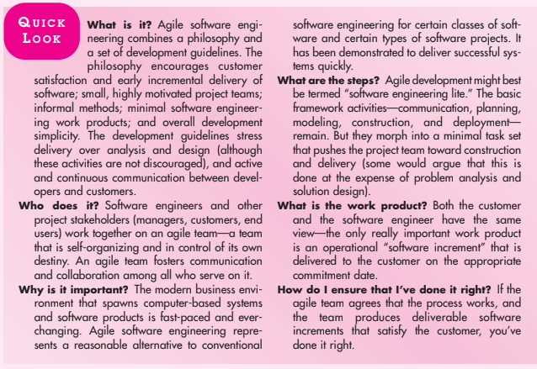
Agility Development

Slide 2
What is Agility ?
Agility has become today’s buzzword when describing a modern software process. Everyone is agile. An agile team is a nimble team able to appropriately respond to changes.
Change is what software development is very much about. Changes in the software being built, changes to the team members, changes because of new technology, changes of all kinds that may have an impact on the product they build or the project that creates the product.
An agile team recognizes that software is developed by individuals working in teams and that the skills of these people, their ability to collaborate is at the core for the success of the project.
The pervasiveness of change is the primary driver for agility. Software engineers must be quick on their feet if they are to accommodate the rapid changes.

Slide 3
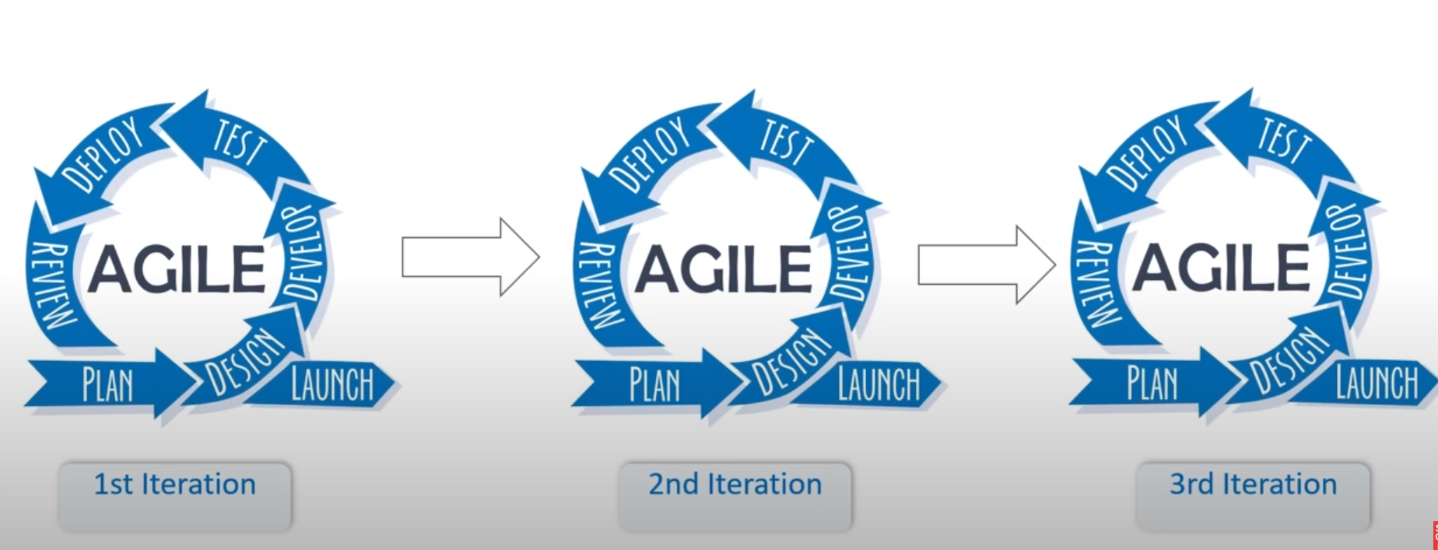
What is Agility ?

Slide 4
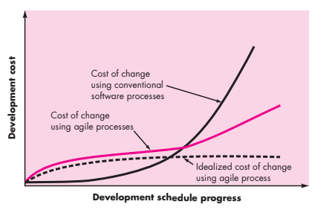
Agility and Cost of Change

Slide 5
Agile Manifesto
Individuals and interactions over processes and tools
Working Software over comprehensive documentation
Customer collaboration over contract negotiation
Responding to change over following a plan

Slide 6
Characteristics of Agile Process
It is difficult to predict in advance which software requirements will persist and which will change. It is equally difficult to predict how customer priorities will change as the project proceeds.
For many types of software, design and construction are interleaved. That is, both activities should be performed in tandem so that design models are proven as they are created. It is difficult to predict how much design is necessary before construction is used to prove the design.
Analysis, design, construction, and testing are not as predictable (from a planning point of view) as we might like.

Slide 7
Principles of Agile Process
Customer satisfaction
Deliver Working software
Measure of progress
Late changes are welcome
Face to face communication
Motivated individuals
Technical excellence
Simplicity
Regular Adoption

Slide 8
Human Factor
Competence
Common focus
Collaboration
Decision making ability
Problem solving ability
Mutual trust and respect

Slide 9
Extreme Programming (XP)
1. XP values
defines a set of five values that establish a foundation for all work performed as part of XP— communication, simplicity, feedback, courage, and respect. Each of these values is used as a driver for specific XP activities, actions, and tasks.

Slide 10
Extreme Programming (XP)
2. XP Process
Extreme Programming uses an object-oriented approachas its preferred development paradigm and encompasses a set of rules and practices that occur within the context of four framework activities: planning, design, coding, and testing. Figure illustrates the XP process and notes some of the key ideas and tasks that are associated with each framework activity.

Slide 11
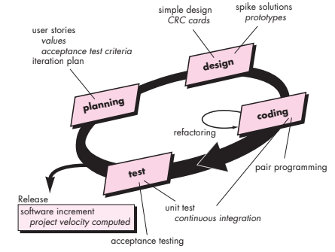
XP Process

Slide 12
Scrum
Scrum principles are consistent with the agile manifesto and are used to guide development activities within a process that incorporates the following framework activities: requirements, analysis, design, evolution, and delivery.
Within each framework activities, work task occurs within a process pattern called Sprint.

Slide 13
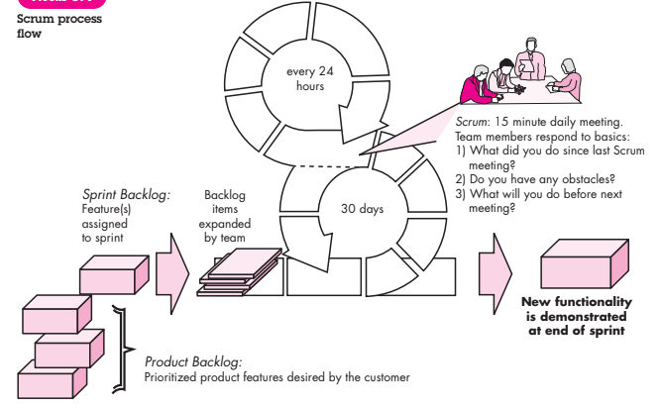
Scrum

Slide 14
Kanban
Agile Kanban is Agile Software Development with Kanban approach. In Agile Kanban, the Kanban board is used to visualize the workflow. The Kanban board is normally put up on a wall in the project room. The status and progress of the story development tasks is tracked visually on the Kanban board with flowing Kanban cards.
Kanban Board
Kanban board is used to depict the flow of tasks across the value stream. The Kanban board −
Provides easy access to everyone involved in the project.
Facilitates communication as and when necessary.
Progress of the tasks are visually displayed.
Bottlenecks are visible as soon as they occur.

Slide 15
Kanban
The tasks and stories are represented by Kanban cards. The current status of each task is known by displaying the cards in separate columns on the board. The columns are labeled as To Do, Doing, and Done. Each task moves from To Do to Doing and then to Done.
Kanban Board is updated on a daily basis as the team progresses through the development.
WIP Limit
The label in the Doing column also contains a number, which represents the maximum number of tasks that can be in that column at any point of time. i.e., the number associated with the Doing column is the WIP (Work-In-Progress) Limit.
Pull Approach
Pull approach is used as and when a task is completed in the Doing column. Another card is pulled from the To Do column.

Slide 16
Kanban
Self-directing
In Agile Development, the team is responsible for planning, tracking, reporting and communicating in the project. Team is allowed to make decisions and is accountable for the completion of the development and product quality. This is aligned to the characteristic of empowerment of the team in Kanban.
Continuous Flow
In Agile development, there is no gate approach and the work flows across the different functions without wait-time. This contributes in minimizing the cycle time characteristic of Kanban.

Slide 17
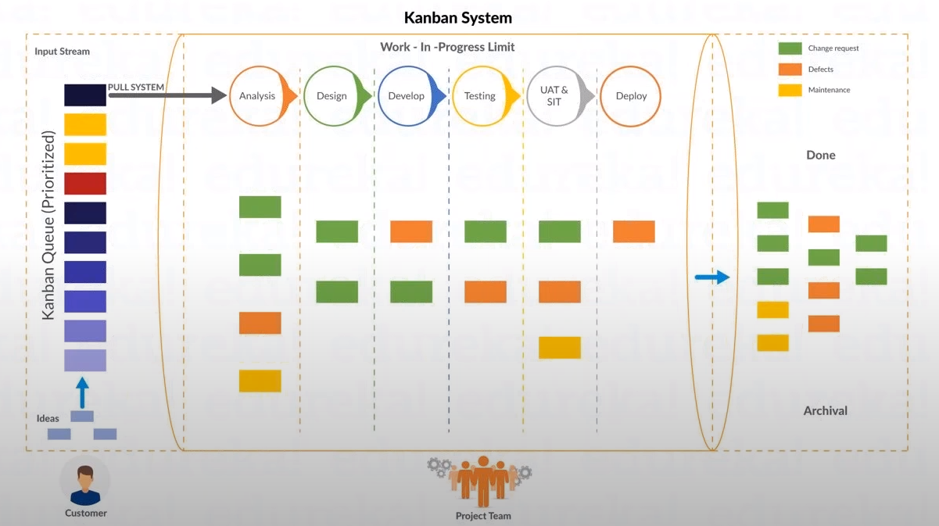
Kanban

Slide 18
How to set up a simple Kanban system for a software development team.

Slide 19
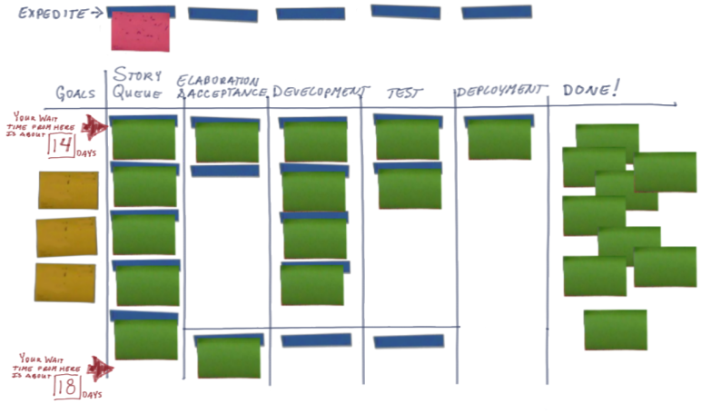
1. Define a work process flow
This simple process flow has the steps:
elaboration & acceptance criteria
development
test
deployment
Look at the typical flow for features, stories, or work packages and describe typical process steps

Slide 20
2. Lay out a visual Kanban board
Place an expedite track above the main left to right queue
Place “done and waiting” queues between each work queue
(in this example they’re placed below)
Place a goals column on the left, then a waiting queue, the process steps, and a final “done” column to the right

Slide 21
3. Decide on limits for items in queue and work in progress
This board uses painters tape to indicate available “slots” for work in progress
A good limit is a factor of the number of people in a role that can work on an item in a given process step. Start with number of people * 1.5

Slide 22
4. Place prioritized goals on the left column of the board
Having goals visible:
promotes focus
helps us prioritize
helps us manage feature scope & requirements
A good goal describes the outcome we hope to achieve after software ships. Goals help keep focus on the larger outcome.

Slide 23
5. Start the board by placing stories or features in queue
Product owners manage the waiting queue
Mark on the story or feature card the date it entered the queue. This begins our measurement of cycle time.

Slide 24
6. Move features through the process flow as work is completed
As the story enters the first process step, mark that date on the card. This is the start date. As it’s finished, mark that date on the card. This is the finish date.

Slide 25
7. Use the dates on the cards to calculate cycle time
Cycle time = finish date – start date
The average cycle time from the date the item enters the board is the wait time from this point in the queue
Use average cycle time to set wait times from different points on the board. Pay attention to flow and bottlenecks: relieving bottlenecks as quickly as possible.

Slide 26
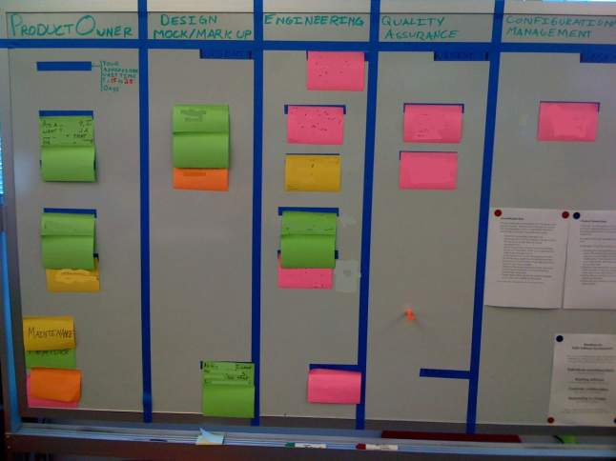
Kanban Boards

Slide 27
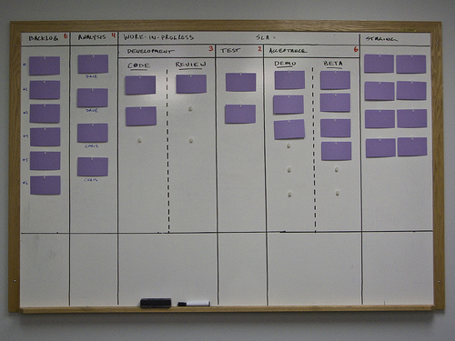
Kanban Boards

Slide 28
Kanban
Advantages of Kanban board
Empowerment of Team
Team is allowed to take decisions as and when required.
Team collaboratively resolves the bottlenecks.
Team has access to the relevant information.
Team continually communicates with customer.
Continuous Delivery
Focus on work completion.
Limited requirements at any point of time.
Focus on delivering value to the customer.
Emphasis on whole project.

